Slide 1


Deep learning & Convolutional neural network (CNN)
Sugandh Gupta
Gril lab

Slide 2
Lecture Outcomes:
Understand the concept of Convolution Neural Networks
Understand the important terms and concepts involved in Convolution Neural Networks

Slide 3
contents
What is Deep Learning?
Applications
Base Models
How Neural Network Works?
Activation Functions
Concept of Backpropagation
Cost Function
MultiLayer Neural Network training
Gradient Descent

Slide 4
contents
Loss Functions
What is Convolutional Neural Network?
Convolution Operation in CNN
Padding
Max Pooling
Finally the CNN architecture
Important Metrics

Slide 5
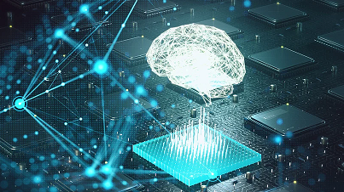
What is Deep Learning?
Mimics the human brain
(network of neurons in brain)
Type of machine learning based on artificial neural network
Multiple layers of processing used to extract progressively higher level features from data

Slide 6
Applications
Robotics
Medical Field
Self Driving Cars
Translation

Slide 7
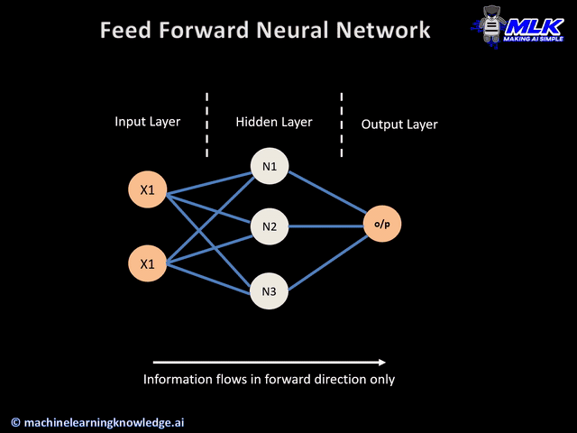
What is Neural Network?
An Arificial Neural Network (ANN or NN) with multiple layers between Input and Output layers
Input Layer
Hidden Layer
Output Layer

Slide 8
Base Models
Artifcial Neural Network
Convolutional Neural Network
Recurrent Neural Network
(RNN)

Slide 9
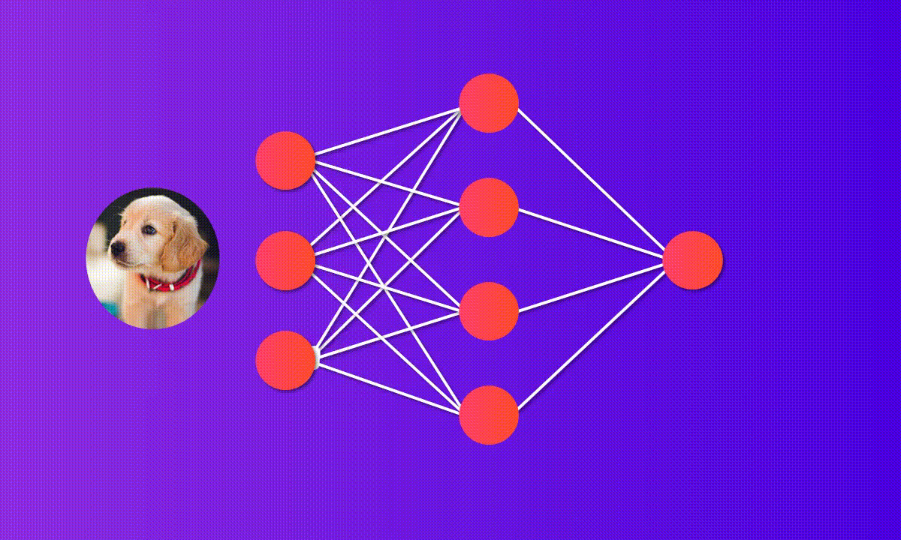
How Neural network works?
X1
W1
W3
X2
W4
X3

Slide 10
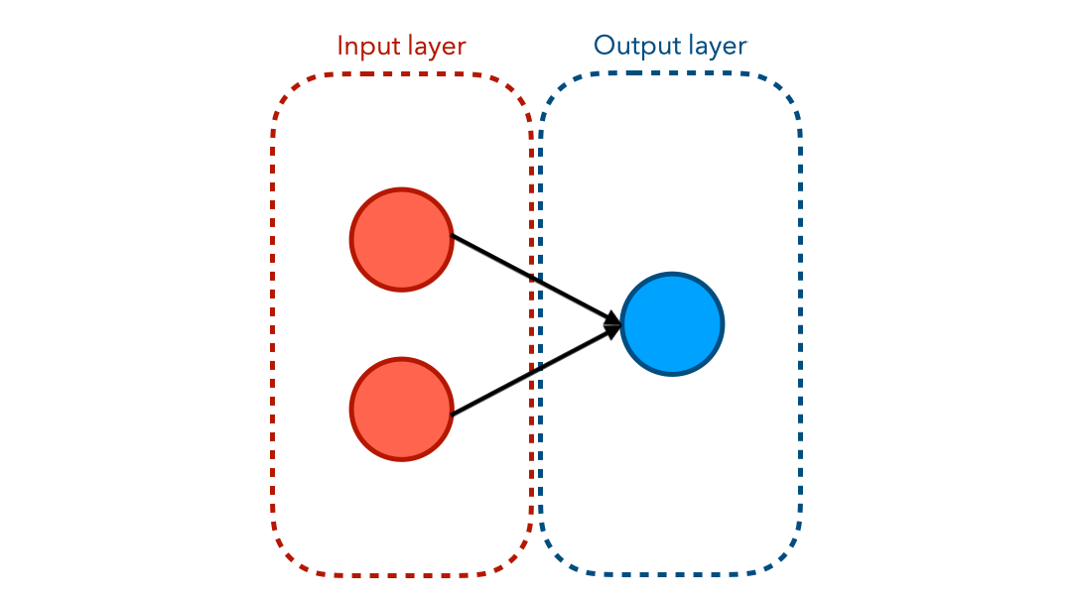
Neural Network
Perceptron/Single Neural Network
Multi Layer Perceptron
Input
Weights
X1
W1
Neuron
OUTPUT
X2
W2
Y = w1 * X1 + w2 * X2 + Bias

Slide 11
How Neural network works?
Input (with weights, W) Fed(from input layer to 1st Hidden Layer)
Neuron in every Layer (Performs 2 tasks)
Step 2
Step 1
Z = Act(Y)
Y = ∑WiXi + Bias
Output Layer

Slide 12

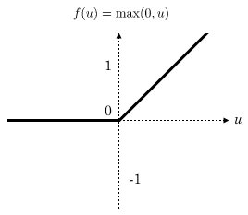
ACTIVATION FUNCTIONS
Sigmoid Function
ReLU Function
1/(1+e^{-y})
Max(y,0)

Slide 13
Neural network Training
X1
Y’ = Predicted Value
Y = Actual Value
W1
X2
Loss function = (y-y’)²
W2
W4
y’
W3
X3
y
Loss Function Minimized by
Optimizers
Note: Predicted value depends on weights, bias

Slide 14
Concept of backpropagation
Gradient Descent
Optimizer adjusts the weights to minimize loss function
X1
Stochastic Gradient Descent
W1
Backpropagation
X2
W2
W4
y
Weights Updated
^{W}_{new} ^{= W}_{old} – ƞdL/W_{old}
W3
X3
y’
Forward propagation
ƞ = Learning Rate
L = Loss Function
Process Repeat until loss function Minimized

Slide 15


Slide 16
Loss Functions
Two Types of Problems: Classification & Regression
Current Area of Interest: Classification
Categorical Cross Entropy (Multi Class Cross Entropy)
_{Loss = -} ∑ _{Yij Log (Yij’)}
_{Yij =1 (if i}^{th} _{element is present}
in class j)
_{Yij =1 (if i}^{th} _{element is present}
in class j)
Predicted value calculated by Sigmoid Function
Cross Entropy (Binary)
Loss = -y log(y’) – (1-y) log (1-y’)
_{= – log (1-y’) if y = 0}
₌ _{- log(y’) if y =} ₁
Predicted value calculated by Sigmoid Function

Slide 17
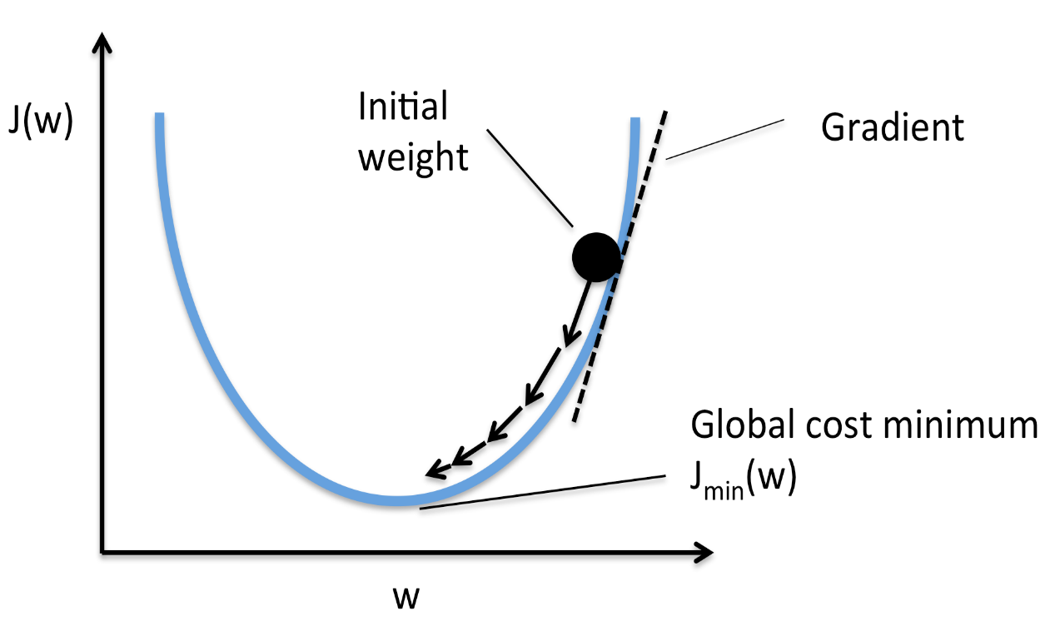
Gradient Descent
^{W}_{new} ^{= W}_{old} – ƞdL/w_{old}
Learning Rate should be wisely chosen
(Neither too High nor too low)

Slide 18
Multilayer Neural Network Training
Input Layer
X1
Hidden Layer 1
W1
X2
Hidden Layer 2
W2
W4
Output Layer
W3
X3
X4
2 x 1
3 x 2
4 x 3

Slide 19
Convolutional Neural Network vs Human Brain
CNN Most suitable when the input is in the form of images or video frames
Human Brain
Inception of an image
Cerebral cortex → Visual cortex
Visual Cortex contains various Layers
V1, V2, V3, V4…..
Each Layer performs specific function
This Whole Process has been tried to get involved in a machine

Slide 20
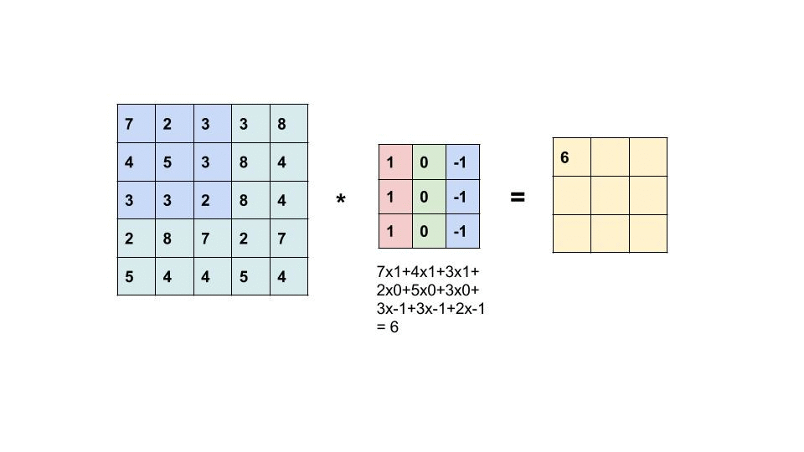
Convolution operation in cnn
Image (N = 5)
*
Filter/Kernel
(F = 3)
Output (O)
=

Slide 21
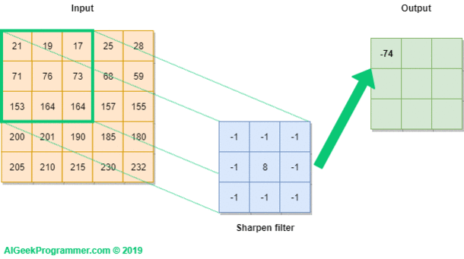
Concept of striding

Slide 22
Convolution operation in cnn
Apply the filter on the input Image Matrix
Multiply the corresponding elements of both the matrix and Take the sum
Apply the Striding (one jump horizontally and one jump vertically)
Output Achieved by N-F+1

Slide 23
Shortcoming with general cnn
U have an Image of 6 x 6(for example)
Output = 4 x 4
Some information is lost from the Image
What is the solution?
Padding

Slide 24
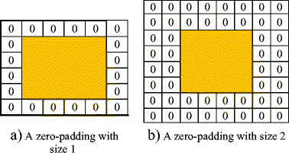
Padding
Zero Padding (Popular)
Neighbour Padding
Padding is simply a process of adding layers of zeros to our input images so as to avoid the problems mentioned above.
Formula Changes to
N + 2P - F +1
P = 1

Slide 25
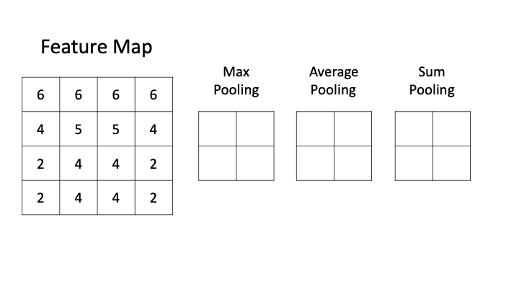
Concept of Pooling
Image (N = 6)
Filter (F = 3)
Output (O)
*
=
Pooling

Slide 26
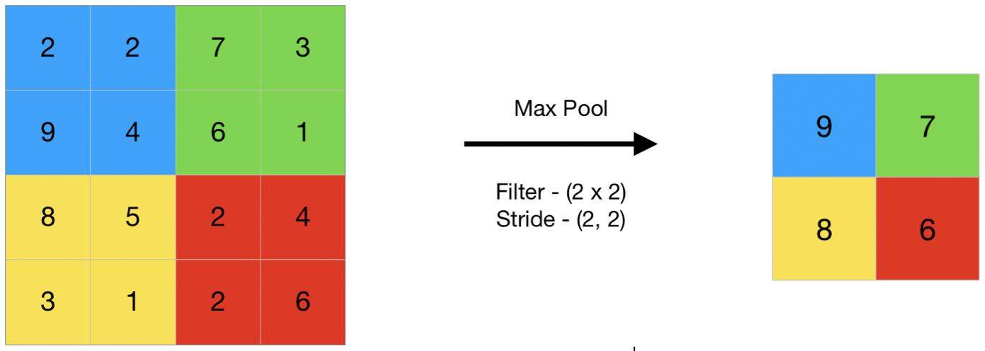
Max Pooling
Image (N = 6)
Filter (F = 3)
Output (O)
*
=
Max Pooling Layer
Max pooling is a pooling operation that selects the maximum element from the region of the feature map covered by the filter.

Slide 27
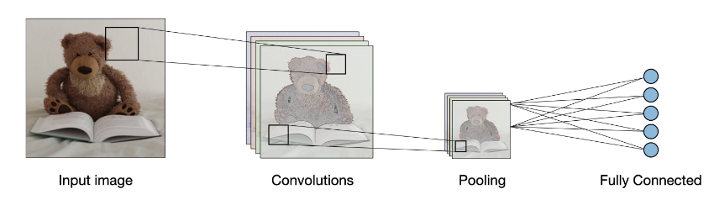
Finally CNN Architecture

Slide 28
Important Metrics in Object Detection
Precision
Recall
Ratio of the number of true positives to the total number of positive predictions.
Ratio of the number of true positives to the total number of actual (relevant) objects.
For example, if the model detected 100 trees, and 90 were correct, the precision is 90 percent.
For example, if the model correctly detects 75 trees in an image, and there are actually 100 trees in the image, the recall is 75 percent.
Precision = (True Positive)
(True Positive + False Positive)
Recall = (True Positive)
(True Positive + False Negative)

Slide 29
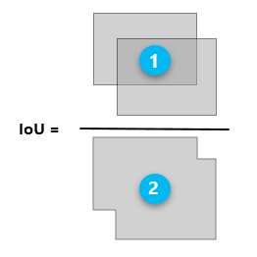
Important Metrics (contd…)
Intersection over Union(IoU) :
Precision-Recall Curve
Phenomenon in object detection that describes how boxes overlap.
Used as a threshold for determining whether a predicted outcome is a true positive or a false positive.
Plot of precision (y-axis) and recall (x-axis)
considered a good predictive model if the precision stays high as the recall increases

Slide 30
Important Metrics (contd…)
Average Precision
Mean Average Precision (mAP)
Area under the curve of the precision-recall curve
Generally used for Single Class
Average AP over multiple IoU thresholds.
Generally used for Multiple Class

Slide 31
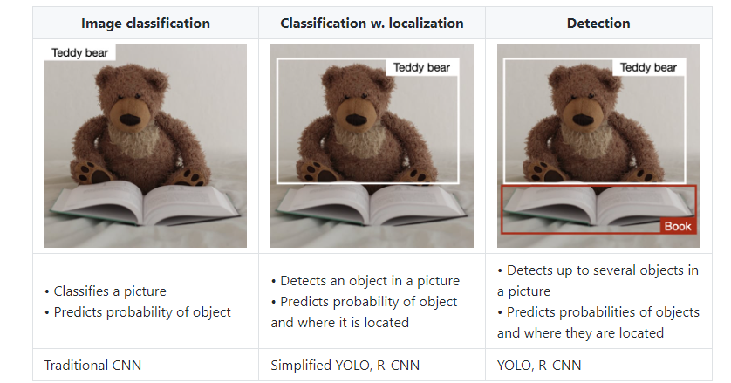
TYPES OF MODELS
Ref: https://stanford.edu/~shervine/teaching/cs-230/cheatsheet-convolutional-neural-networks

Slide 32
Thank you…..

